Slide 1




CMR ENGINEERING COLLEGE
(UGC AUTONOMOUS)
(Accredited by NBA,Approved by AICTE NEW DELHI, Affiliated to JNTU, Hyderabad) Kandlakoya, Medchal Road, Hyderabad-501 401
Department of Computer Science & Engineering MAJOR PROJECT ON
ACTIVE ONLINE LEARNING FOR SOCIAL MEDIA ANALYSIS TO SUPPORT CRISIS MANGEMENT
Internal Guide:-
Mrs.Y.Prathima Assistant Professor,
Dept. of CSE.
By
P. Pravalika
P.Alfa
R.Venu
MD. Rahman Shareef
: (208R1A0547)
: (218R5A0546)
: (208R1A0548)
: (208R1A0552)
A.Y 2023-2024

Slide 2
ABSTRACT
Social media platforms have become vital sources of information during crises and emergencies. Traditionally, crisis management teams relied on manual methods or simple keyword-based filters to sift through social media like Twitter and Facebook are becoming crucial channels for information dissemination .Data during emergencies ,the vast amount of data generated during a crisis can be overwhelming. Developing a system that can autonomously select and label the most informative posts or messages related to a crisis. The goal is to filter out noise and focus on the data that is most likely to provide critical insights for crisis response and management.

Slide 3
INTRODUCTION
Social media platforms have become vital sources of information during crises and emergencies, they allow for real-time communication and information sharing among a wide range of users .During crisis, timely and accurate information is paramount for effective response and management.
The use of social media (SM) in crisis management gained prominence in the early 21st century, with platforms like Twitter and Facebook becoming crucial channels for information dissemination during emergencies. Such data would enable emergency operations centers to act and organize the rescue and response.
Crisis management teams relied on manual methods or simple keyword-based filters to sift through social media data.the vast amount of data generated during a crisis can be overwhelming and it was time-consuming and less efficient during emergencies.
The goal is to filter out noise and focus on the data that is most likely to provide critical insights for crisis response and management.
By leveraging machine learning algorithms, this approach can dynamically select and label data points that are most likely to provide valuable insights for crisis response.
This enables crisis management teams to focus their attention on the most relevant information, improving the speed and effectiveness of their response efforts.

Slide 4
LITERATURE SURVEY
A prototype-based classification approach operates on data items mapped to a vector representation (e.g., vector space model for text data). Data points are classified via prototypes considering similarity measures. Prototypes are adapted based on items related/similar to them. A Rocchio classifier [37] is an example of a single prototype-based classifier. It distinguishes between two classes, e.g., “relevant” and “irrelevant”. In real world-scenarios, due to the nature of the data, it is often not possible to describe the data with a single prototype-based classifier. Multiple prototype classifiers (i.e., several prototypes) are needed.
Self-organizing maps (SOM) introduced by Kohonen [32] are an unsupervised version of prototype-based classification, also known as LVQ. In this case, prototypes are initialized (e.g., randomized) and adapted. SOM was also used for SM analysis in the context of crisis management to identify important hotspots [50]. LVQ has been applied to several areas, e.g., robotics, pattern recognition, image processing, text classification etc. [20], [32], [62]. LVQ - in the context of similarity representation, rather than vector-based representation - is analyzed by Hammer et al. [25].

Slide 5
EXISTING METHODOLOGY
The traditional system heavily relies on manual efforts for data collection, preprocessing, analysis, and decision-making, which can be labour-intensive, time-consuming, and potentially less accurate compared to automated systems powered by machine learning and natural language processing techniques. In addition, they suffer from inefficiency, lack of scalability, limited coverage, subjectivity, delayed insights, incapability to handle multimodal data, absence of predictive analytics, and potential security and privacy challenges
DISADVANTAGES:
Manual Analysis
Lack of Scalability:
Security and Privacy Concerns:
Lack of real time analysis
Absence of Predictive analysis
Security and privacy concerns

Slide 6
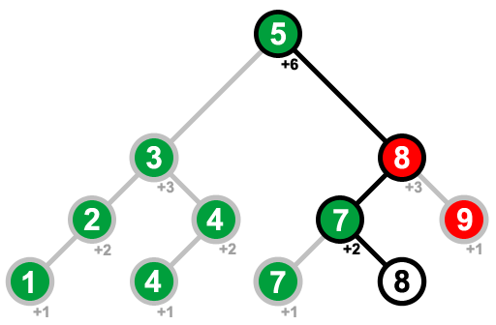
PROPOSED METHODOLGY
OBJECTIVES:
The project aims to analyze social media data to unveil patterns and trends, enabling timely decision-making during crisis situations. It focuses on predicting the location of tweets based on their content.
ADVANTANGES:
Graphical User Interface (GUI):
Data Preprocessing:
Feature Extraction
Machine Learning Model
Persistence and Optimization

Slide 7
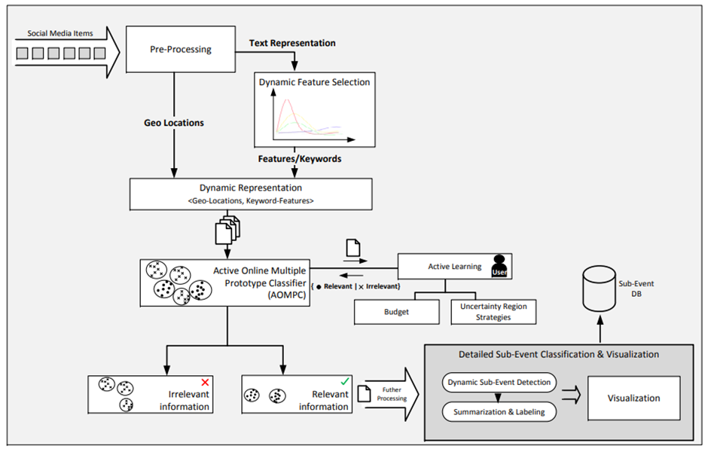
ARCHITECTURE:

Slide 8

SOFTWARE REQUIREMENT SPECIFICATIONS
Python IDLE 3.7 version (or)
Anaconda 3.7 (or)
Jupiter (or)
Google colab
This Photo by Unknown author is licensed under CC BY.

Slide 9

HARDWARE REQUIREMENTS
Operating system : Windows, Linux
Processor : minimum intel i3
Ram : minimum 4GB
Hard disk : minimum 250GB

Slide 10
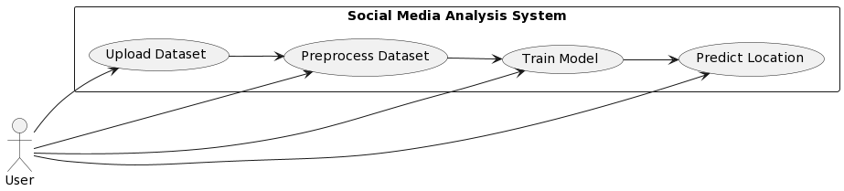
UseCase Diagram :

Slide 11
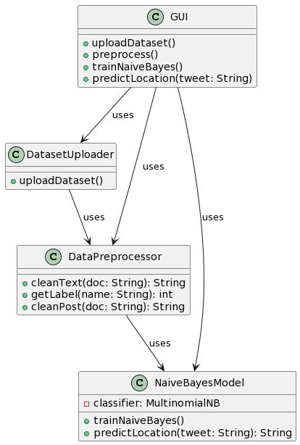
Class Diagram :

Slide 12
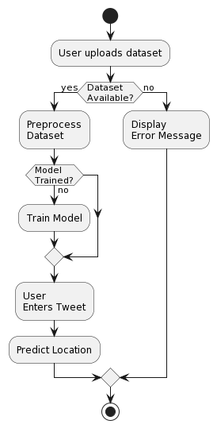
Activity Diagram :

Slide 13
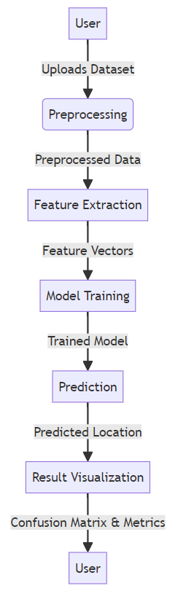
Dataflow Diagram :

Slide 14
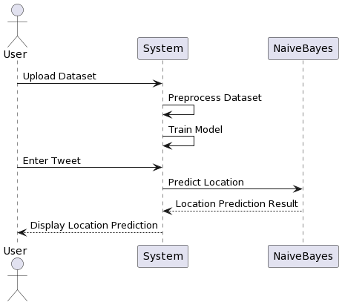
Sequence Diagram :

Slide 15
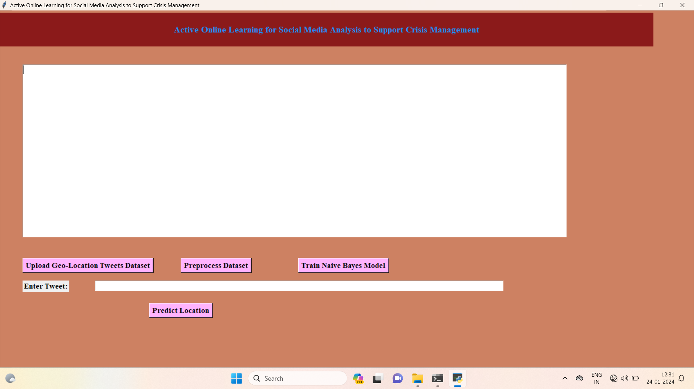
SCREENSHOTS OF OUTPUT

Slide 16
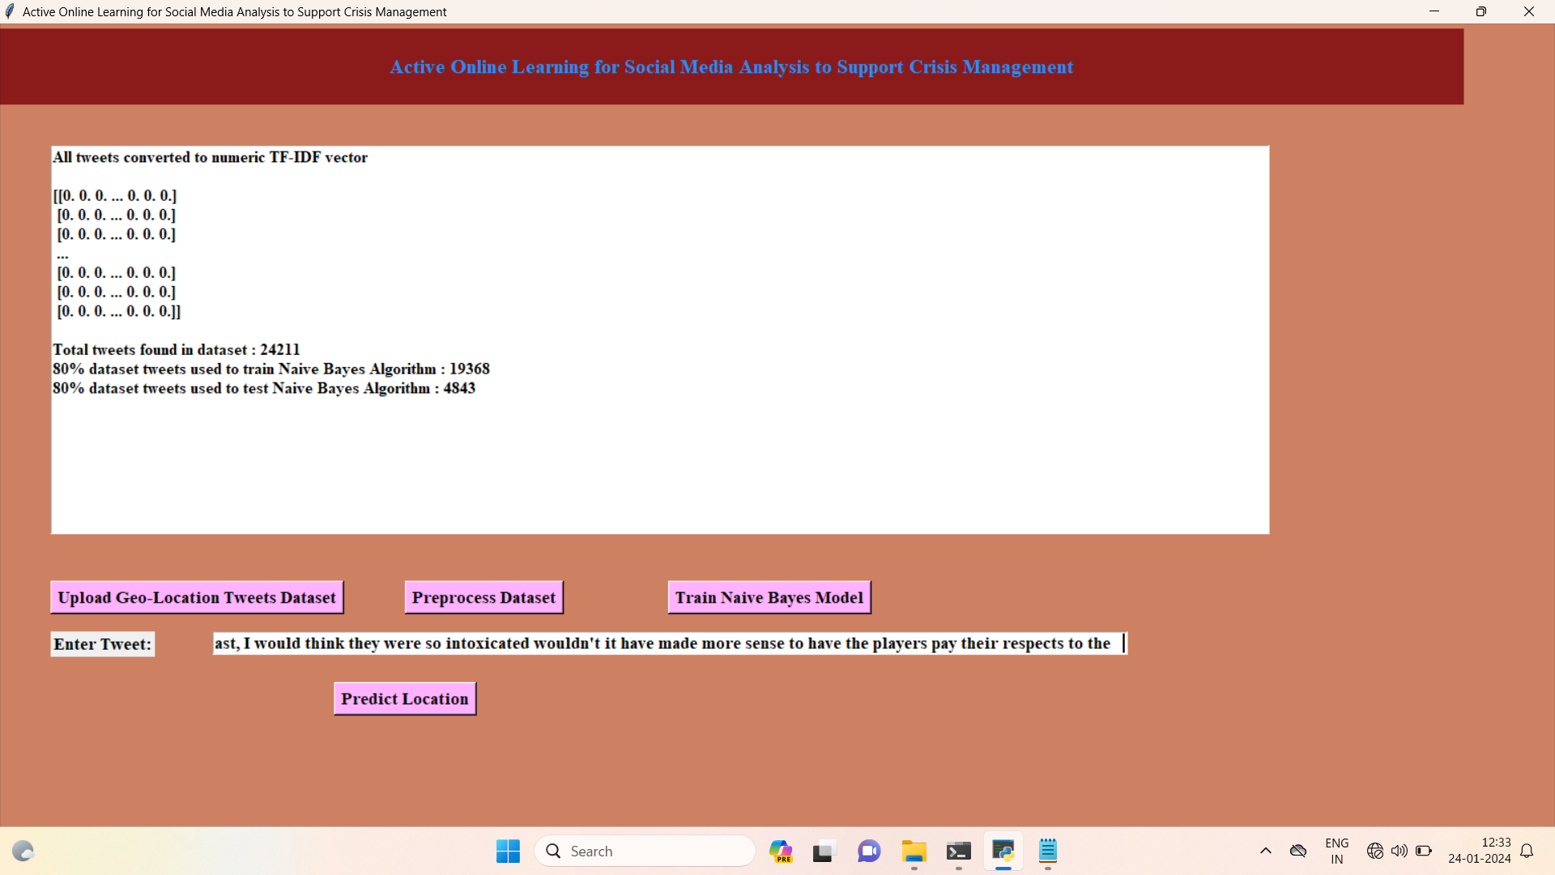
Preprocess Dataset

Slide 17
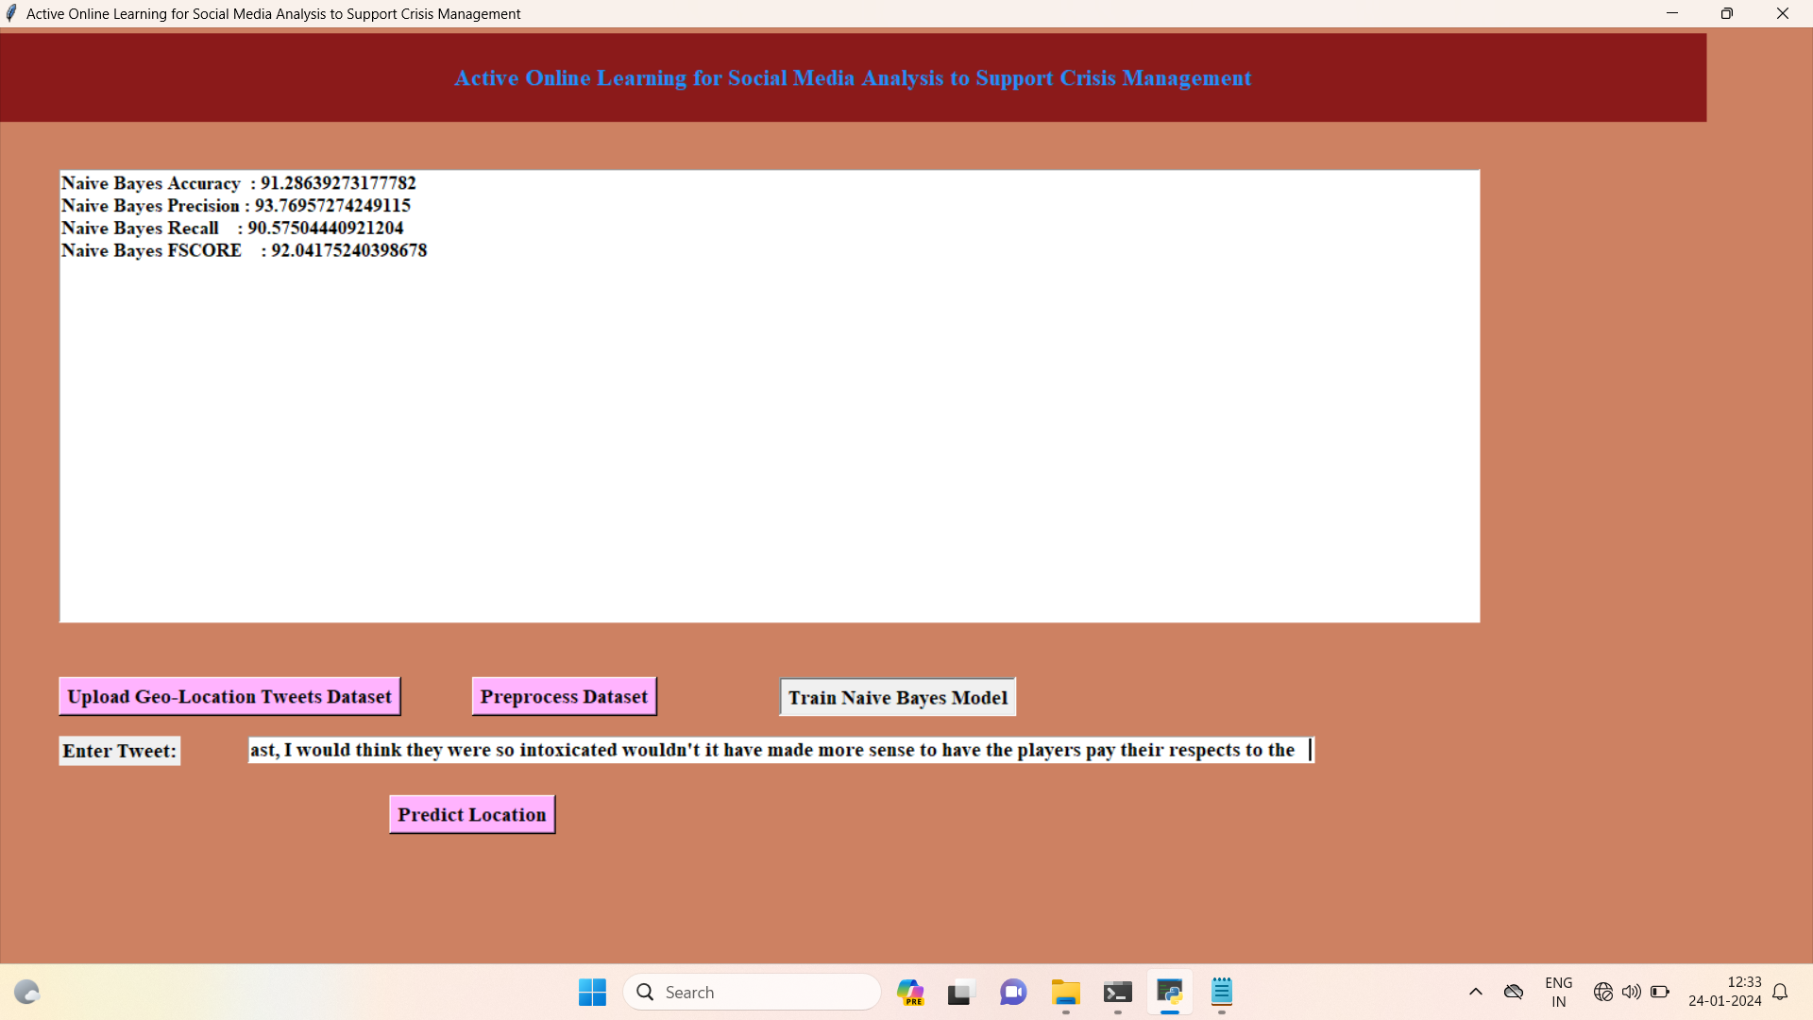
Navie Bayes Model

Slide 18
REFERENCES:
[1] F. Abel, C. Hauff, G.-J. Houben, R. Stronkman, and K. Tao, “Semantics + Filtering + Search = Twitcident. Exploring Information in Social Web Streams,” in Proc. of the 23rd ACM Conf. on Hypertext and Social Media. ACM, 2012, pp. 285–294.
[2] U. Ahmad, A. Zahid, M. Shoaib, and A. AlAmri, “Harvis: An integrated social media content analysis framework for youtube platform,” Information Systems, vol. 69, pp. 25 – 39, 2017.
[3] G. Backfried, J. Gollner, G. Qirchmayr, K. Rainer, G. Kienast, G. Thallinger, C. Schmidt, and A. Peer, “Integration of Media Sources for Situation Analysis in the Different Phases of Disaster Management: The QuOIMA Project,” in Eur. Intel. and Security Informatics Conf., Aug 2013, pp. 143–146.
[4] BBC News Europe. (2012, Aug.) England Riots: Maps and Timeline. [Online]. Available: http://www.bbc.co.uk/news/ uk-14436499

Slide 19
Future Scope :
The project's future scope includes expanding the model's capabilities to handle multilingual and multimedia content, enabling analysis of diverse social media data. Integration with real-time data sources and advanced sentiment analysis techniques could enhance the system's responsiveness and accuracy. Implementing deep learning architectures like recurrent neural networks (RNNs) or transformer models could capture complex contextual relationships in text, further improving location prediction accuracy. Moreover, incorporating geospatial visualization tools and interactive dashboards would enhance the project's usability, aiding decision-makers in understanding crisis patterns intuitively. Continuous updates and retraining the model with evolving social media trends ensure the system remains effective in capturing emerging crisis-related insights, making it a valuable tool for proactive crisis management in the future.

Slide 20
Conclusion :
In conclusion, the Social Media Crisis Analytics project offers a robust solution for understanding patterns and trends within social media data, enabling timely decision-making during crises. By harnessing the power of natural language processing and machine learning techniques, the project successfully preprocesses and analyzes social media posts. The preprocessing step ensures that the textual data is cleaned, transformed, and optimized for analysis. Through TF-IDF vectorization, the project effectively converts the textual content into numerical features, facilitating the training of a Naive Bayes classifier.

Slide 21
THANK YOU A-14

